Slide 1
History Heroes Term 2, Week 6
https://www.youtube.com/watch?v=lXgkuM2NhYI 0.50-1.00

Slide 2
Question 1 (4 marks)
What are the four types of assessment in modern history?

Slide 3
Question 2 (2 marks)
Which two government systems do we look at when studying German history?

Slide 4
Question 3 (1 mark)
Germany is located…?

Slide 5
Question 4 (4 marks)
When completing a source analysis, if the question askes you to, “Compare and contrast the message of source 1 and 2,” what are the four things you must do?

Slide 6
ANSWERS

Slide 7
Question 1
What are the four types of assessment in modern history?
Historical inquiry, explanation (essay), source analysis, examination

Slide 8
Question 2
Democracy
Dictatorship

Slide 9
Question 3 (1 mark)
Germany is located…?
In Europe

Slide 10
Question 4 (4 marks)
State the message of source 1.
State the message of source 2.
Compare the message of the two sources (what is similar about the message).
Contrast the message of the two sources (what is different about the message of the two sources).

Slide 11
Total score /11

Slide 12


Source
of
the
week!

Slide 13
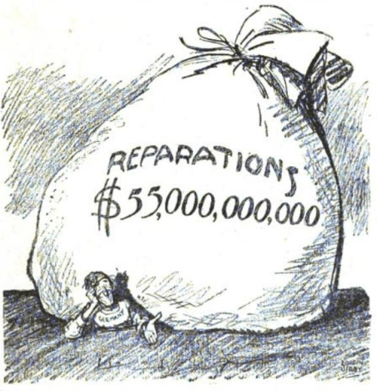
Historical context
Where?
What?
When?
Cause?
Effect?
Significance?

